Slide 1
Discussion 1: Introduction
Brandon Lim
u1244501

Slide 2
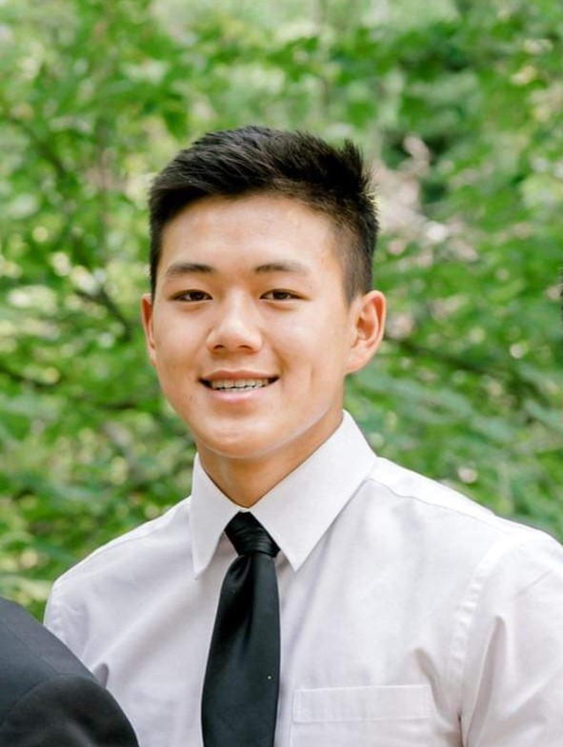
My name is Brandon Lim
This is my senior year at the University of Utah where I am studying mechanical engineering
A fun fact about me is that I am passionate about bodybuilding and am currently pursuing an International Federation of Body Building Pro Card

Slide 3
Optimal Aging Self Definition
Optimal aging to me is the continuous progression in life that brings happiness and feelings of self fulfillment.
My initial definition of optimal aging was aging while having practices that improved health so that you can continue to live longer and therefor experience more things that bring more happiness. After some thought, I have come to the realization that optimal aging does have a major tie to happiness and development but not so much the quantity of it but rather the quality.
For example, a climber can optimally age by progressing in free solo climbing throughout their lives because it brings them happiness and feelings of self fulfillment. It might be the most dangerous type of climbing and mistakes could certainly be life threatening, but those climbers are happier by the mountains they are able to climb dangerously rather than the many hills they can climb safely.

Slide 4
Optimal Aging Example
Someone I know who exemplifies optimal aging is my friend Andrew.
Andrew does not follow a general route to financial freedom or success that family members and friends would wish for him. Instead, he tries to live every moment on this earth doing what makes him happy. He takes long camping trips and even longer backpacking trips and refuses to live in a system where he must work the same 9 to 5 every day. This brings him self fulfillment and happiness.
Although this is something that most adults would frown upon because he isn’t continuously making improvements in his financial or career life, he is aging optimally through his self fulfillment and happiness.

